Slide 1

- Demystified
Naren Thilla
Feb 26th 2014

Slide 2

Objective(s)
What we aim to achieve:
To bring a base-line understanding of the Hadoop eco-system.
Help Jumpstart Hadoop Installation and Implementation.
To clear some of the “cloud” surrounding Hadoop.
Focus on fundamentals.
Methodology:
Hands-on practice based sessions combined with theory
Cohort system encourages project execution based on group learning, POCS and presentation
Volunteers encourage to present their learnings and findings individually or in a group.
Free riders discouraged.
What this will NOT give you:
Make you a Hadoop expert
Author’s Background in Hadoop:
Logistics:
Project Co-ordinator – Conf. Booking, DL,
Tech PM - SOC, downloads, links, setup, QA Bank, wiki, parking lots

Slide 3
Agenda
Topic | Session | Mentor
Introduction to Hadoop | 1
Hadoop Installation | 1 (To be done by Self) | ??
Understanding the Hadoop Stack – Hue, Sqoop, Hive, Hbase, etc Playing with Hadoop – Loading files etc | 2
The Proposed Hadoop Stack << Team Spark SQL, Spark Streaming + Team BI formation>> << Election of a Leads + PM >> | 2 | << Jumpstart sessions with individual teams>> - Naren
Introduction to HDFS & MR | 3
Data Ingestion with Sqoop and Talend | 4 | Member from a previous group
Introduction to Hive + Hive POC | 5,6 | Member from a previous group
Introduction to Spark | 7,8
Spark SQL, Hive on Spark, Spark on Hive | 9,10 | Team Spark SQL - Present their POC
Spark Streaming | 11
Real-time Data Ingestion using Spark Steaming Demo on Real Time Data Ingestion into Hadoop | <TBD> | Team - Spark Streaming to Present their POC
BI on Spark (MSTR, Tableau, Qlikview on Spark/Zoomdata on Spark) | <TBD> | Team – BI to present their POC

Slide 4

Part – I : Introduction

Slide 5
What is Hadoop?
An Apache open-source data management framework for processing large amounts of data.
Provides ability to manage high volume and high variety
- Offers reliability by making data redundant inherently.
Offers a large Compute Grid and a large Data Grid
Had its origin in Google (GFS and MR)
Compute Grid (MR )
Data Grid (HDFS)
Machine

Slide 6
Hadoop – Distributed Framework
Compute Grid (MR )
Compute Grid (MR )
Compute Grid (MR )
Data Grid (HDFS)
Data Grid (HDFS)
Data Grid (HDFS)
Machine - 2
Machine - 3
Machine - 1

Slide 7


Hadoop – Key Features
Self healing network of hardware/software
High bandwidth
High power compute grid and high power storage grid.
Inherently batch centric (Hadoop 2.0 gets around this).
Inherently scalable
Add more nodes => Get extra compute & storage power – almost linearly!
Runs on Commodity Hardware !
Scale out vs. Scale up
Handles the 3V’s of data efficiently.

Slide 8

What Hadoop is NOT?
Not suitable for typical OLTP applications
Does not offer Strict ACIDity (e.g. offers eventual consistency)
Not suitable for highly interactive queries.
Does not offer secondary indexing capability
Inherently inefficient to “seek” fields.
Not suitable if the Data volume is low (<10 TB).
Not suitable for real-time, low latency processing!!
The biggest challenge is to understand the Hadoop’s use case!
Does not replace RDBMS or traditional DW

Slide 9
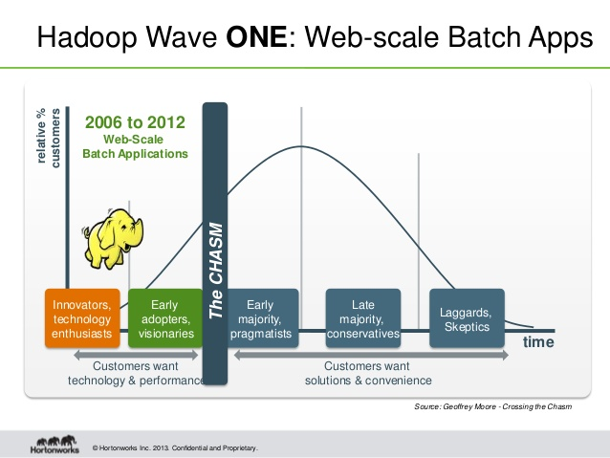
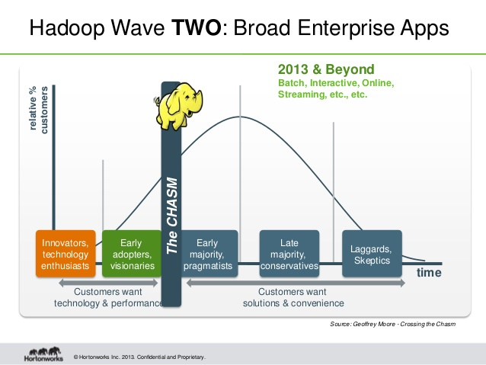
Source: Hortonworks

Slide 10

Big Data - Key Drivers

Slide 11
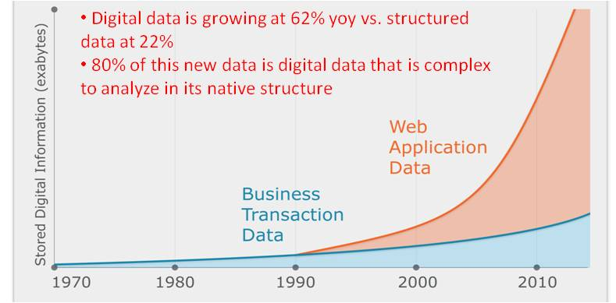
The Volume Driver
Volume Growth
0.18 ZB (10 ²¹) in 2006 vs. 1.8 ZB (in 2011), 2.7 in 2014 *
7 TB of data processed by Twitter every day!
10 Tb by Facebook
5 Billion mobile phone (Think WhatsApp)
90% of world’s data was generated in the last 2 years !!!
Notes:
* Roughly 200 billion HD Movies

Slide 12
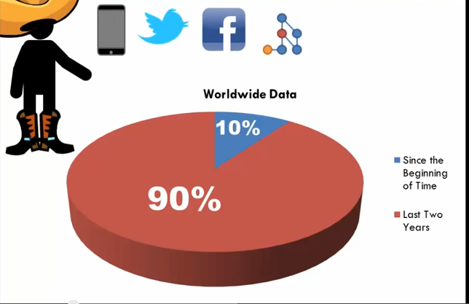
The Variety and Velocity Drivers
Variety Growth
80% of world’s data is unstructured !!!
Velocity Growth
90% of the current world’s data is from the last 2 years!!
Need ability to store massive chunks of data in real time!

Slide 13
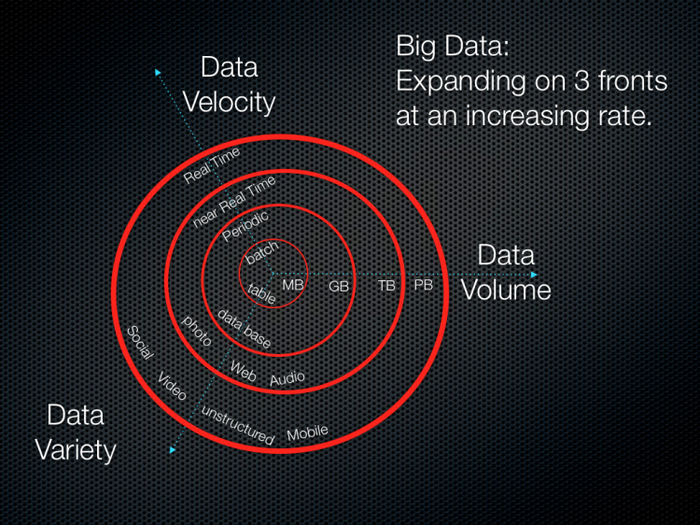
The 3Vs of Data

Slide 14
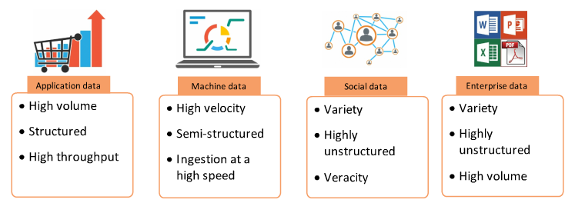
Big Data - Sources

Slide 15
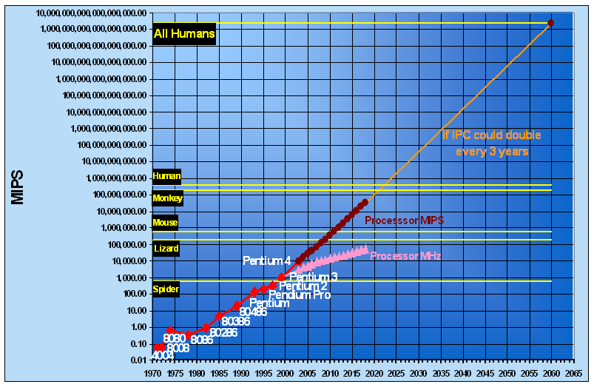
Computation Growth Driver
Growth in computing power
Doubles every 18 months!!
Transfer speed
from 4.4 MB/s in 1990 to 100 MB/s in 2013
@ 100 MBps => 2.5 hours to read 1 TB; Writing is even slower.
How to solve it??
Soln: Enter – The power of MPP
100 drives of 10 GB each => 100 seconds + cost of distributing and aggregating workload
Again, wastage is good !!

Slide 16
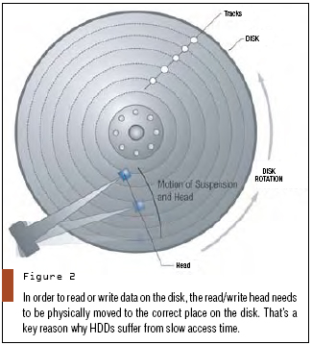
Seek Speed – A Key Driver
What about Seek speed?
Seek speeds grow at a much, much slower rate than transfer rate.
From 600 ms in 1970s to 4ms today (Wikipedia)
Think Disk Fragmentation
Avoid seeks, inserts are cheaper than updates;
Go for Bulk processing

Slide 17
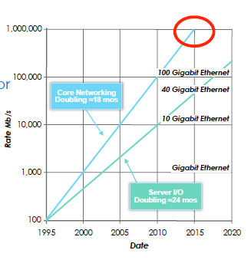
Network Speed - Driver
Network Speed
From 10 Mbps in the 1980s to 100 Gbps
IEEE 802.3ba (Ethernet standard for 100 Gbps)

Slide 18
Important Speeds
Memory Transfer Rate | DDR2 SDRAM 400 – 3200 MB/sec or ~3.2 GBps http://en.wikipedia.org/wiki/DDR2_SDRAM
Disk – Transfer Speed | 100 Mbps (2.5 hours to read 1 TB). Writes are even slower SSDs- 550 MBps write speed. (Cost $0.1 per GB vs. 0.06 per GB)
Disk – Seek Speed | 4 ms (More the fragmentation, the worse off it is for you )
Network Speed | 1 Gbps LAN, 10 Gbps (WAN), 40 Gbps (High end backplanes) 100 Gbps (future?)- mainly within data centers
Compute Speed | GPUs ??

Slide 19
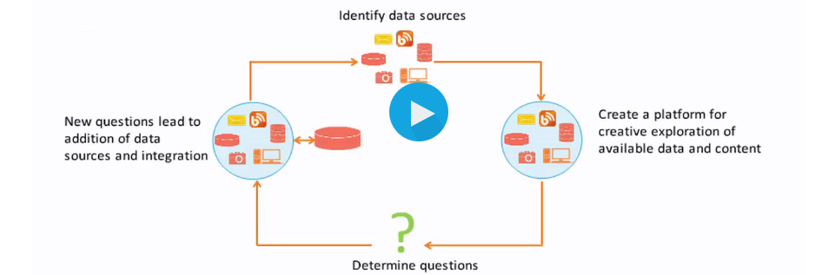
The Business Driver – I need answers Now!

Slide 20





Key Drivers – Summing up
+
=
+
+
Storage
Network
Compute Grid

Slide 21
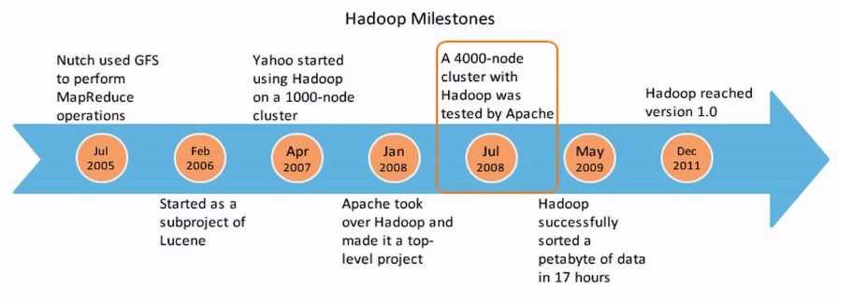
Hadoop Milestones

Slide 22

Hadoop – The Architectural Assumptions
Notes:
Victor Enrich – Warped Architecture
http://www.visualnews.com/2012/08/04/victor-enrich-architecture/

Slide 23

Points to Ponder
How do I move large data quickly?
How can I accommodate System Failures?
Seek time improvement is growing very slowly – What can I do about it?
I am Twitter… 10 TB of Data is generated a day!! How do I store them??
IO is slower, much slower than memory. This trend is not likely to change
Notes:
Move Large Data – Bandwidth/Latency Tradeoff
Redundancy
Don’t seek
Focus on write; Reads can come in later ; Build a massive pipe
Move code to data

Slide 24
Points to Ponder
6) Data volume is growing rapidly, non linear hardware & Software costs will be prohibitive to organizations – What do I do?
7) How can I leverage existing developer community
Notes:
6) Use commodity hardware ; open source the software; Linear growth model
7) Java is the new Linux!

Slide 25
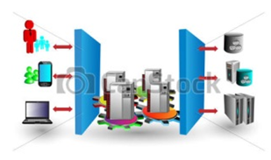
The Latency/Bandwidth Tradeoff – Arch. Assumptions
#1: The High Latency, High Bandwidth Paradigm
Efficient for moving “large” chunks of data;
Inefficient for moving “small” dataset.

Slide 26
Disk, Node & N/W Failures – Arch. Assumptions
#2: Failure is not an option; it is a must !!
=> Network Failure Node Failures Disk Crashes
=> Redundancy @ Node and Rack Level
Solution:
Wastage is good !!
33% throughput = ok!
The Analogy with Network Redundancy - BLSR, UPSR vs. Mesh Networks.
=> Commodity Hardware is a must (is it?? How about Backplanes)

Slide 27
What about Seek Time?
#3 Simple Coherence Model
- only appends; no inserts
Seek time is most expensive.
Want to change one field in a trillion row under a millisecond -> Sorry!!

Slide 28
How to handle Fast Moving Data?
#4 The Schema on Read paradigm vs. Schema on Write Paradigm
Flexible Schema; Suitable for Document Mgmt style requirements
No secondary indexing possible!
Allows for massive scale writes, slower reads (as schema is enforced at read time)
Operates on WORM (Write once Read Many) Data
Updates not possible. Only appends are allowed

Slide 29
I/O is still slower than memory – Arch Tradeoff
#5. Moves algorithms to Data
Optimizes on Data movement
Analogous to ELT paradigm
Notes:
Double the data, the job runs @ half the speed;
Double the cluster, the job runs @ the original speed;

Slide 30
Scale up vs. Scale out – Arch Assumptions
#6. Commodity Hardware; Open source Software
Adds capacity linearly
Adding more nodes gives more computer power and more storage (almost linearly)!!!
1 Terabyte sorting in 62 seconds (May 2009)
1 Petabyte @ 16.5 hours http://developer.yahoo.com/blogs/hadoop/hadoop-sorts-petabyte-16-25-hours-terabyte-62-422.html
Notes:
Double the data, the job runs @ half the speed;
Double the cluster, the job runs @ the original speed;

Slide 31
Leverage Existing Dev community
#7. Java is the new Linux!!
Although Hadoop Pipe talks C++
Hadoop Vendors tapping into R, Python.
New languages such as Scala, Julia, Go are added to the ecosystem rapidly.
Support for SQL processing is huge !!
Notes:
Double the data, the job runs @ half the speed;
Double the cluster, the job runs @ the original speed;

Slide 32
Maintaining State information across Clusters – The Arch. Assumptions
#8. Shared Nothing Architecture
- Memory or Disk is NOT shared
- Name Node & Job Tracker

Slide 33
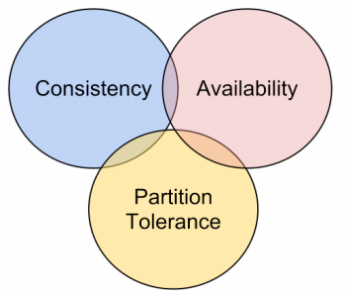
The Architectural Assumptions & Compromises (Contd..)
#9: CAP Theorem
- Eventually consistent vs. Strongly consistent
- Not all 3, but, at best, only 2 possible
- Eventually Consistent vs. atomicity
EC => Set(12); Set (10); Get() = 10
Why is AC difficult to achieve?
Right from left and read from right…
Hadoop chooses availability over consistency (imagine a 3 node failure)
Notes:
Availability = Eventually Available
Consistency = Atomic and Linear
Partition Tolerance = Network Failure = ok

Slide 34
Key Aspects
Hadoop is mainly suitable for OLAP use cases.
Most Data pipelines on Hadoop are built as a uni-directional flow.
As of mid 2015, Hadoop is not suitable for OLTP transactions.
However, the Stinger initiative from Hortonworks attempts to bring transaction capabilities to the Hadoop eco-system
Hadoop started off as a batch eco-system.
However, newer technologies such as Spark, KAFKA etc brings ad-hoc capabilities to Hadoop.
The original compute engine based on MR is likely to be replaced by Spark and/or other compute engines.

Slide 35

Challenges
Hadoop Administration is a critical challenge
Current use cases are sub-optimal for under 10Tb volume
Data usage is atypical of traditional companies
Does not fit in a typical OLTP or OLAP shop

Slide 36

Hadoop Resources

Slide 37
Knowledge Base
KB | Link
Tutorials | Hortonworks – Tutorial: http://hortonworks.com/products/hortonworks-sandbox/#tutorial_gallery Hortonworks –Developer Training : http://cloudera.com/content/cloudera/en/training/library/developers.html Hortonworks – Analyst Training: http://cloudera.com/content/cloudera/en/training/library/analysts.html Don’t forget to click on the Tutorial link within the distribution: http://cloudera.com/content/cloudera/en/training/library/analysts.html
Books | Hadoop – The Definitive Guide – 3rd Edition – Tom White Learning Spark – Holden Karau Apache Sqoop Cookbook – Kathleen Ting Programming Hive – Dean Wampler

Slide 38
Knowledge Base
KB | Link
Videos | Introducing Apache Hadoop – The Modern Operating System – Amr Awadallah (https://www.youtube.com/watch?v=d2xeNpfzsYI) Best Practices for the Hadoop Data Warehouse: EDW 101 for Hadoop Professionals http://www.cloudera.com/content/cloudera/en/resources/library/recordedwebinar/best-practices-for-the-hadoop-data-warehouse-video.html Parallel Programming with Spark – Matei Zaharia https://www.youtube.com/watch?v=e-56inQL5hQ Spark: Introduction to Spark – By DataBricks https://www.youtube.com/watch?v=VWeWViFCzzg

